Slide 1
COMP30027 MACHINE LEARNING
TUTORIAL
Workshop - 3

Slide 2
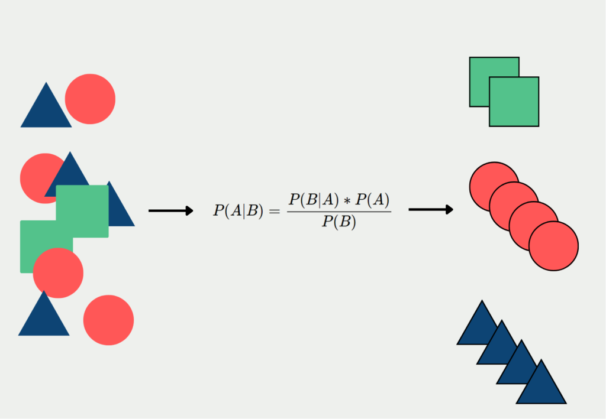
Naive Bayes
Naive Bayes is a simple yet powerful probabilistic classifier. It's known for its efficiency and effectiveness in various machine learning applications. These include spam filtering, text classification, etc. In some cases, it outperforms complex models, especially on smaller datasets.

Slide 3
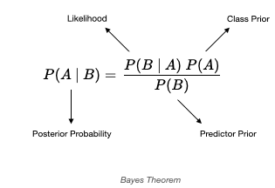
Understanding the Naive Bayes Equation
Evidence
The Naive Bayes equation is P(A|B) = [P(B|A) * P(A)] / P(B). This calculates the probability of hypothesis A given evidence B.
Components
Key Assumption
Posterior: Probability of A given B
Feature independence is assumed, which is why it's "Naive".
Prior: Probability of A before evidence
Likelihood: Probability of B given A
Evidence: Probability of B

Slide 4
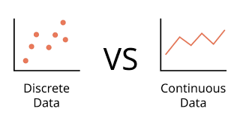
Discrete vs. Continuous
Data comes in different forms. Naive Bayes handles them differently. For continuous data, discretization or Gaussian Naive Bayes is used.
Discrete
Continuous
It consists of distinct, separate values and does not take fractional or decimal values between them.
A continuous value can take an infinite number of values within a given range.

Slide 5
Q1
Which attribute is discrete and which is continuous?
Discrete
Continuous
ID | Color | Weight (g)
1 | Red | 1021.2
2 | Red | 1027.0
3 | Red | 1012.5
4 | Blue | 1010.4
5 | Blue | 1019.5
6 | Gold | 1016.4
7 | Gold | 995.4
8 | Gold | 1012.8
Discrete vs. Continuous

Slide 6
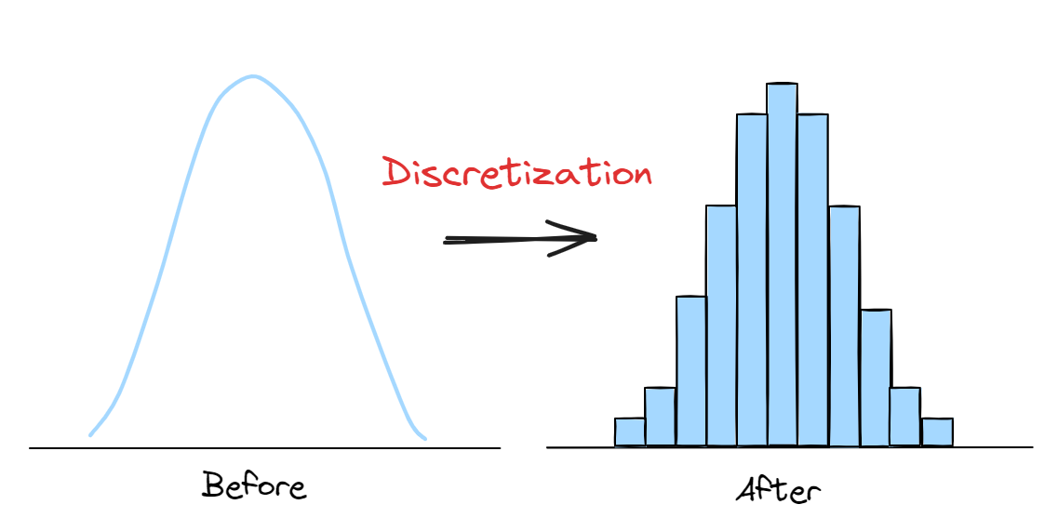
Discretisation
Discretisation is the process of converting a continuous variable (temperature, weight) into a discrete one by dividing its range into finite intervals ("low", "medium", and "high”).
Three discretisation techniques are:
Equal Width
Equal Frequency
K-means
Divides the range of values into bins of equal size (equal width)
Each bin contains approximately the same number of data points.
Convert continuous values into groups (e.g., Salary into low, medium, high)

Slide 7
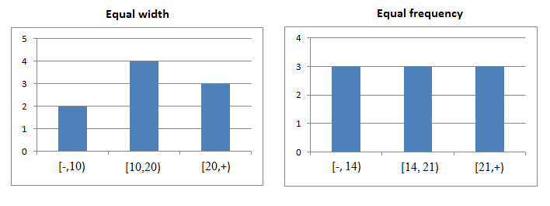
Discretisation
Equal Width
Equal Frequency
K-means
Divides the range of values into bins of equal size (equal width)
Each bin contains approximately the same number of data points.
Convert continuous values into groups (e.g., Salary into low, medium, high)

Slide 8
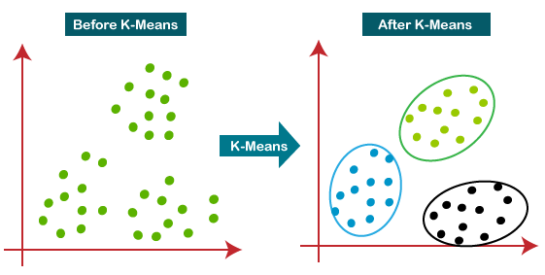
Discretisation
Equal Width
Equal Frequency
K-means
Divides the range of values into bins of equal size (equal width
Each bin contains approximately the same number of data points.
Convert continuous values into groups (e.g., Salary into low, medium, high)

Slide 9
Discretisation
Discrete
Continuous
ID | Color | Weight (g)
1 | Red | 1021.2
2 | Red | 1027.0
3 | Red | 1012.5
4 | Blue | 1010.4
5 | Blue | 1019.5
6 | Gold | 1016.4
7 | Gold | 995.4
8 | Gold | 1012.8
Q2
Discretise the continuous attribute into 2 bins using the (unsupervised) methods of equal width, equal frequency, and k-means (break ties where necessary).

Slide 10
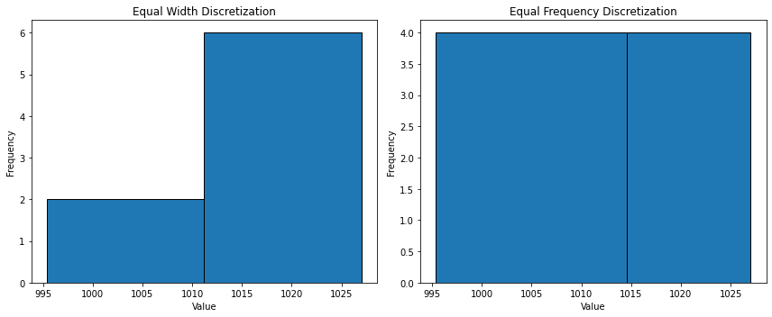
ID | Color | Weight (g)
1 | Red | 1021.2
2 | Red | 1027.0
3 | Red | 1012.5
4 | Blue | 1010.4
5 | Blue | 1019.5
6 | Gold | 1016.4
7 | Gold | 995.4
8 | Gold | 1012.8
Equal Width
Equal Frequency

Slide 11
Step-by-Step Discretisation Using K-Means (k = 2)
Initialize Two Random Centroids
Assign Each Point to the Nearest Centroid
Compute New Centroids
Reassign Each Point to the New Centroids

Slide 12
ID | Color | Weight (g)
1 | Red | 1021.2
2 | Red | 1027.0
3 | Red | 1012.5
4 | Blue | 1010.4
5 | Blue | 1019.5
6 | Gold | 1016.4
7 | Gold | 995.4
8 | Gold | 1012.8
Initialize Two Random Centroids
We randomly choose two initial centroids. Let’s assume:
Centroid 1: 1021.2
Centroid 2: 995.4

Slide 13
Assign Each Point to the Nearest Centroid
Weight | Distance to Centroid 1 (1021.2) | Distance to Centroid 2 (995.4) | Assigned Cluster
1021.2 | 0 | 25.8 | 1
1027.0 | 5.8 | 31.6 | 1
1012.5 | 8.7 | 17.1 | 1
1010.4 | 10.8 | 15.0 | 1
1019.5 | 1.7 | 24.1 | 1
1016.4 | 4.8 | 21.0 | 1
995.4 | 25.8 | 0 | 2
1012.8 | 8.4 | 17.4 | 1
Compute New Centroids
New centroid for each cluster is the mean of the assigned weights.
New Centroid 1: (1021.2+1027.0+1012.5+1010.4+1019.5+1016.4+1012.8)/7= 1017.11
New Centroid 2: Since only 995.4 is in Cluster 2, the centroid remains 995.4.

Slide 14
Reassign Each Point to the New Centroids
Weight | Distance to New Centroid 1 (1017.11) | Distance to Centroid 2 (995.4) | Assigned Cluster
1021.2 | 4.09 | 25.8 | 1
1027.0 | 9.89 | 31.6 | 1
1012.5 | 4.61 | 17.1 | 1
1010.4 | 6.71 | 15.0 | 1
1019.5 | 2.39 | 24.1 | 1
1016.4 | 0.71 | 21.0 | 1
995.4 | 21.71 | 0 | 2
1012.8 | 4.31 | 17.4 | 1
No change from the previous assignment of clusters, so we can stop
Bin 1 (Centroid = 1017.11): {1021.2, 1027.0, 1012.5, 1010.4, 1019.5, 1016.4, 1012.8}
Bin 2 (Centroid = 995.4): {995.4}

Slide 15
ID | Color | Weight (g)
1 | Red | 1021.2
2 | Red | 1027.0
3 | Red | 1012.5
4 | Blue | 1010.4
5 | Blue | 1019.5
6 | Gold | 1016.4
7 | Gold | 995.4
8 | Gold | 1012.8
Q3
How could the discrete variable be converted to a continuous numeric variable?
ID | R | B | G | Weight (g)
1 |  |  |  | 1021.2
2 |  |  |  | 1027.0
3 |  |  |  | 1012.5
4 |  |  |  | 1010.4
5 |  |  |  | 1019.5
6 |  |  |  | 1016.4
7 |  |  |  | 995.4
8 |  |  |  | 1012.8

Slide 16
Q3
How could the discrete variable be converted to a continuous numeric variable?
R – 1 0 0
B – 0 1 0
G – 0 0 1
ID | R | B | G | Weight (g)
1 | 1 | 0 | 0 | 1021.2
2 | 1 | 0 | 0 | 1027.0
3 | 1 | 0 | 0 | 1012.5
4 | 0 | 1 | 0 | 1010.4
5 | 0 | 1 | 0 | 1019.5
6 | 0 | 0 | 1 | 1016.4
7 | 0 | 0 | 1 | 995.4
8 | 0 | 0 | 1 | 1012.8

Slide 17
Naive Bayes Equation
Evidence
The Naive Bayes equation is P(A|B) = [P(B|A) * P(A)] / P(B). This calculates the probability of hypothesis A given evidence B.
Components
Key Assumption
Posterior: Probability of A given B
Feature independence is assumed, which is why it's "Naive".
Prior: Probability of A before evidence
Likelihood: Probability of B given A
Evidence: Probability of B

Slide 18
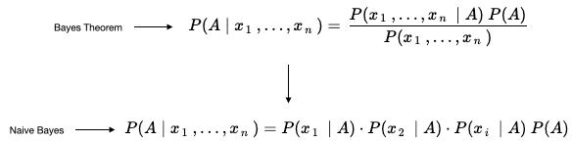
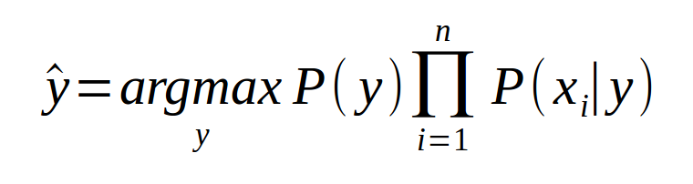
Naive Bayes Classifier
T= < x₁ , x_{2,} . . . . ., x_{n} >
Instance
A
Class
Naïve assumption: Feature independence
A
A
A
A

Slide 19
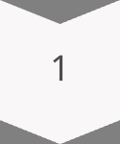
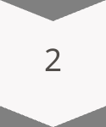
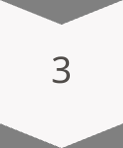
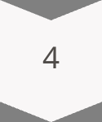
Classifying Data Using Naive Bayes
Classifying data with Naive Bayes involves calculating prior and likelihood probabilities. Then, apply the Naive Bayes equation. Finally, assign the data point to the class with the highest posterior probability.
Calculate priors
Evidence
Calculate likelihoods
Compute posteriors
Assign class

Slide 20
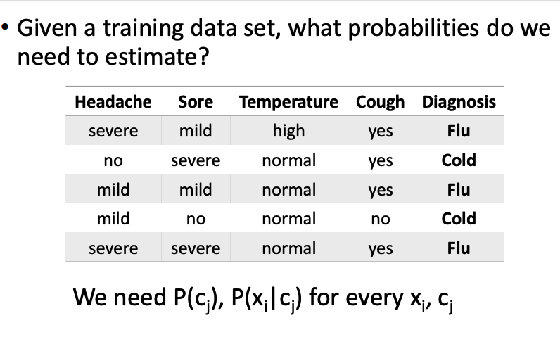
Naive Bayes for Cold/Flu Diagnosis

Slide 21
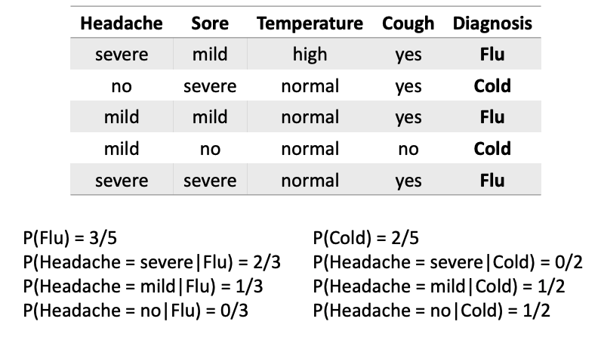
Naive Bayes for Cold/Flu Diagnosis

Slide 22
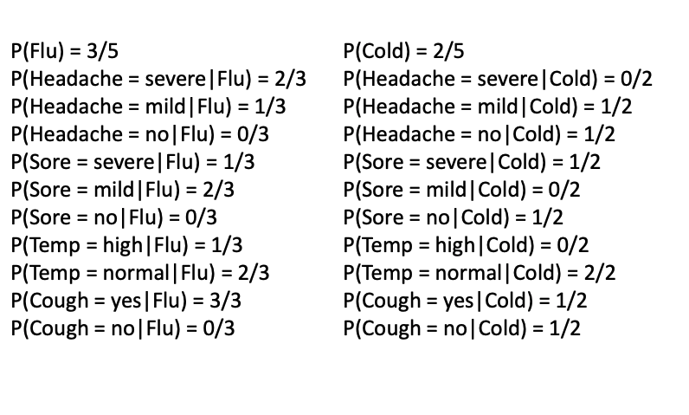
Naive Bayes for Cold/Flu Diagnosis

Slide 23
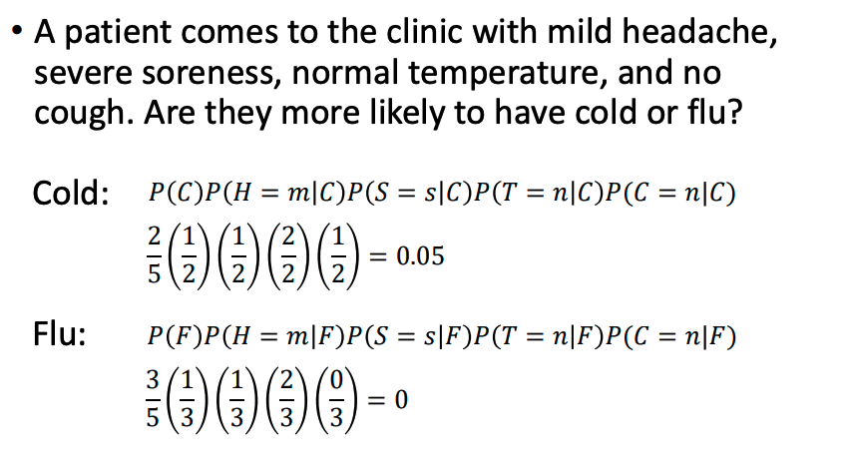
Naive Bayes for Cold/Flu Diagnosis

Slide 24
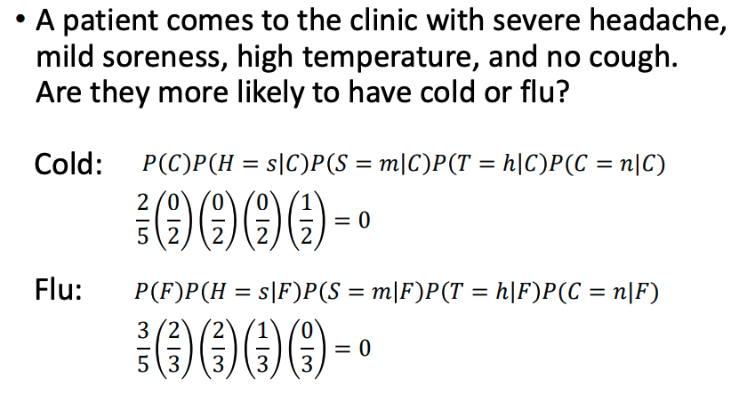
Naive Bayes for Cold/Flu Diagnosis

Slide 25



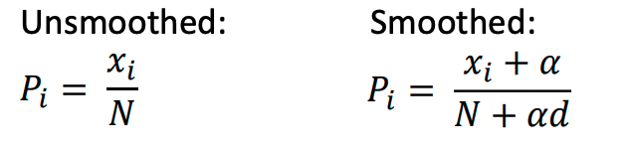
Probabilistic Smoothing
Smoothing is crucial in Naive Bayes to avoid the zero-probability problem. This problem occurs when a feature value doesn't appear in a class. For instance, in the training set of the previous example, the class ‘Cold’ doesn’t have any instances with the feature value “Headache = Severe.” So, the likelihood of observing a severe headache in a person with a Cold is zero. Smoothing techniques, like Laplace and Epsilon smoothing, help to solve this issue.
Laplace Smoothing
Adds 1 or α to each feature count.
Zero Probability
2
Problem: feature absent in a class.
1
Epsilon Smoothing
3
Replace ‘0’ with a value ε (0 < ε < 1).

Slide 26
Naïve Bayes
Given the following dataset, build a Naive Bayes model to predict the label "Play."
ID | Outlook | Temp | Humid | Wind | Play
A | S | H | N | F | N
B | S | H | H | T | N
C | O | H | H | F | Y
D | R | M | H | F | Y
E | R | C | N | F | Y
F | R | C | N | T | N
Q4
Classify the test instances using:
no smoothing
epsilon smoothing
Laplace smoothing (𝛼=1)
Use the model to classify these test instances (? represents missing value):
ID | Outlook | Temp | Humid | Wind | Play
G | O | M | N | T | ?
H | ? | H | ? | F | ?

Slide 27
Solution: Naïve Bayes Model for Classification
We will follow these steps to classify the test instances using Naïve Bayes:
Compute prior probabilities
Compute likelihoods (conditional probabilities) for each feature
Classify test instances using:
No smoothing
Epsilon smoothing (𝜖 = 0.001)
Laplace smoothing (𝛼 = 1)

Slide 28
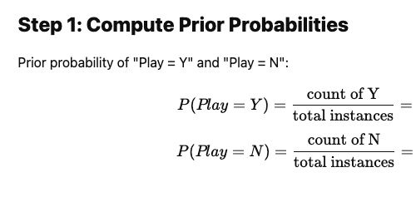
3/6 =0.5
3/6 =0.5

Slide 29

P(Outlook = S | Play = Y) = | P(Outlook = S | Play = N) =
P(Outlook = O | Play = Y) = | P(Outlook = O | Play = N) =
P(Outlook = R | Play = Y) = | P(Outlook = R | Play = N) =
---------------------------------------------- | ----------------------------------------------
P(Temp = H | Play = Y) = | P(Temp = H | Play = N) =
P(Temp = M | Play = Y) = | P(Temp = M | Play = N) =
P(Temp = C | Play = Y) = | P(Temp = C | Play = N) =
---------------------------------------------- | ----------------------------------------------
P(Humid = N | Play = Y) = | P(Humid = N | Play = N) =
P(Humid = H | Play = Y) = | P(Humid = H | Play = N) =
---------------------------------------------- | ----------------------------------------------
P(Wind = T | Play = Y) = | P(Wind = T | Play = N) =
P(Wind = F | Play = Y) = | P(Wind = F | Play = N) =

Slide 30
ID | Outlook | Temp | Humid | Wind | Play
A | S | H | N | F | N
B | S | H | H | T | N
C | O | H | H | F | Y
D | R | M | H | F | Y
E | R | C | N | F | Y
F | R | C | N | T | N
P(Outlook = S | Play = Y) =
=
=
Count of instances with Outlook = S and Play =Y
Total count of instances with Play = Y
0
3
P(Outlook = S | Play = N) =
Count of instances with Outlook = S and Play =N
Total count of instances with Play = N
2
3

Slide 31
P(Outlook = S | Play = Y) = 0 | P(Outlook = S | Play = N) = 2/3
P(Outlook = O | Play = Y) = 1/3 | P(Outlook = O | Play = N) =
P(Outlook = R | Play = Y) =2/3 | P(Outlook = R | Play = N) = 1/3
---------------------------------------------- | ----------------------------------------------
P(Temp = H | Play = Y) = 1/3 | P(Temp = H | Play = N) = 2/3
P(Temp = M | Play = Y) = 1/3 | P(Temp = M | Play = N) = 0
P(Temp = C | Play = Y) = 1/3 | P(Temp = C | Play = N) = 1/3
---------------------------------------------- | ----------------------------------------------
P(Humid = N | Play = Y) = 1/3 | P(Humid = N | Play = N) =2/3
P(Humid = H | Play = Y) = 2/3 | P(Humid = H | Play = N) = 1/3
---------------------------------------------- | ----------------------------------------------
P(Wind = T | Play = Y) = 0 | P(Wind = T | Play = N) = 2/3
P(Wind = F | Play = Y) = 1 | P(Wind = F | Play = N) = 1/3

Slide 32






P(Outlook = S | Play = Y) = 0 | P(Outlook = S | Play = N) = 2/3
P(Outlook = O | Play = Y) = 1/3 | P(Outlook = O | Play = N) =
P(Outlook = R | Play = Y) =2/3 | P(Outlook = R | Play = N) = 1/3
---------------------------------------------- | ----------------------------------------------
P(Temp = H | Play = Y) = 1/3 | P(Temp = H | Play = N) = 2/3
P(Temp = M | Play = Y) = 1/3 | P(Temp = M | Play = N) = 0
P(Temp = C | Play = Y) = 1/3 | P(Temp = C | Play = N) = 1/3
---------------------------------------------- | ----------------------------------------------
P(Humid = N | Play = Y) = 1/3 | P(Humid = N | Play = N) =2/3
P(Humid = H | Play = Y) = 2/3 | P(Humid = H | Play = N) = 1/3
---------------------------------------------- | ----------------------------------------------
P(Wind = T | Play = Y) = 0 | P(Wind = T | Play = N) = 2/3
P(Wind = F | Play = Y) = 1 | P(Wind = F | Play = N) = 1/3
For instance G:
N: P(N) P(Outlook = 0|N) P(Temp = M|N) P(Humid = N|N) P(Wind = T|N) =
Y: P(Y) P(Outlook = 0|Y) P(Temp = M|Y) P(Humid = N|Y) P(Wind = T|Y) =
For instance H
N: P(N) P(Temp = H|N) P(Wind = F|N) =
Y: P(Y) P(Temp = H|Y) P(Wind = F|Y) =
No smoothing
Tie. So, no label assigned

Slide 33


P(Outlook = S | Play = Y) = 0 | P(Outlook = S | Play = N) = 2/3
P(Outlook = O | Play = Y) = 1/3 | P(Outlook = O | Play = N) =
P(Outlook = R | Play = Y) =2/3 | P(Outlook = R | Play = N) = 1/3
---------------------------------------------- | ----------------------------------------------
P(Temp = H | Play = Y) = 1/3 | P(Temp = H | Play = N) = 2/3
P(Temp = M | Play = Y) = 1/3 | P(Temp = M | Play = N) = 0
P(Temp = C | Play = Y) = 1/3 | P(Temp = C | Play = N) = 1/3
---------------------------------------------- | ----------------------------------------------
P(Humid = N | Play = Y) = 1/3 | P(Humid = N | Play = N) =2/3
P(Humid = H | Play = Y) = 2/3 | P(Humid = H | Play = N) = 1/3
---------------------------------------------- | ----------------------------------------------
P(Wind = T | Play = Y) = 0 | P(Wind = T | Play = N) = 2/3
P(Wind = F | Play = Y) = 1 | P(Wind = F | Play = N) = 1/3
Epsilon smoothing (𝜖 = 0.001)
For instance G:
N: P(N) P(Outlook = 0|N) P(Temp = M|N) P(Humid = N|N) P(Wind = T|N) =
Y: P(Y) P(Outlook = 0|Y) P(Temp = M|Y) P(Humid = N|Y) P(Wind = T|Y) =
For instance H
N: P(N) P(Temp = H|N) P(Wind = F|N) =
Y: P(Y) P(Temp = H|Y) P(Wind = F|Y) =

Slide 34
Laplace smoothing (𝛼=1)
The conditional probabilities with Laplace smoothing are:
P(Outlook = S | Play = Y) = | P(Outlook = S | Play = N) =
P(Outlook = O | Play = Y) = | P(Outlook = O | Play = N) =
P(Outlook = R | Play = Y) = | P(Outlook = R | Play = N) =
---------------------------------------------- | ----------------------------------------------
P(Temp = H | Play = Y) = | P(Temp = H | Play = N) =
P(Temp = M | Play = Y) = | P(Temp = M | Play = N) =
P(Temp = C | Play = Y) = | P(Temp = C | Play = N) =
---------------------------------------------- | ----------------------------------------------
P(Humid = N | Play = Y) = | P(Humid = N | Play = N) =
P(Humid = H | Play = Y) = | P(Humid = H | Play = N) =
---------------------------------------------- | ----------------------------------------------
P(Wind = T | Play = Y) = | P(Wind = T | Play = N) =
P(Wind = F | Play = Y) = | P(Wind = F | Play = N) =

Slide 35
(𝛼=1)
Laplace smoothing (𝛼=1)
P(Outlook = S | Play = Y) =
=
=
(Count of instances with Outlook = S and Play =Y) + 1
No. of levels or distinct values
in that Feature
(Total count of instances with Play = Y) + (1 x 3)
‘d’ value for ‘Outlook’ = 3
‘d’ value for ‘Humid’ = 2
1
6
ID | Outlook | Temp | Humid | Wind | Play
A | S | H | N | F | N
B | S | H | H | T | N
C | O | H | H | F | Y
D | R | M | H | F | Y
E | R | C | N | F | Y
F | R | C | N | T | N
P(Outlook = S | Play = N) =
(Count of instances with Outlook = S and Play =Y) + 1
(Total count of instances with Play = Y) + (1 x 3)
3
6

Slide 36
Laplace smoothing (𝛼=1)
The conditional probabilities with Laplace smoothing are:
P(Outlook = S | Play = Y) = 1/6 | P(Outlook = S | Play = N) = 3/6
P(Outlook = O | Play = Y) =2/6 | P(Outlook = O | Play = N) =1/6
P(Outlook = R | Play = Y) = 3/6 | P(Outlook = R | Play = N) =2/6
---------------------------------------------- | ----------------------------------------------
P(Temp = H | Play = Y) = 2/6 | P(Temp = H | Play = N) =3/6
P(Temp = M | Play = Y) =2/6 | P(Temp = M | Play = N) =1/6
P(Temp = C | Play = Y) =2/6 | P(Temp = C | Play = N) =2/6
---------------------------------------------- | ----------------------------------------------
P(Humid = N | Play = Y) =2/3 | P(Humid = N | Play = N) =3/5
P(Humid = H | Play = Y) =3/5 | P(Humid = H | Play = N) =2/5
---------------------------------------------- | ----------------------------------------------
P(Wind = T | Play = Y) =1/5 | P(Wind = T | Play = N) =3/5
P(Wind = F | Play = Y) =4/5 | P(Wind = F | Play = N) =2/5

Slide 37




P(Outlook = S | Play = Y) = 1/6 | P(Outlook = S | Play = N) = 3/6
P(Outlook = O | Play = Y) =2/6 | P(Outlook = O | Play = N) =1/6
P(Outlook = R | Play = Y) = 3/6 | P(Outlook = R | Play = N) =2/6
---------------------------------------------- | ----------------------------------------------
P(Temp = H | Play = Y) = 2/6 | P(Temp = H | Play = N) =3/6
P(Temp = M | Play = Y) =2/6 | P(Temp = M | Play = N) =1/6
P(Temp = C | Play = Y) =2/6 | P(Temp = C | Play = N) =2/6
---------------------------------------------- | ----------------------------------------------
P(Humid = N | Play = Y) =2/3 | P(Humid = N | Play = N) =3/5
P(Humid = H | Play = Y) =3/5 | P(Humid = H | Play = N) =2/5
---------------------------------------------- | ----------------------------------------------
P(Wind = T | Play = Y) =1/5 | P(Wind = T | Play = N) =3/5
P(Wind = F | Play = Y) =4/5 | P(Wind = F | Play = N) =2/5
For instance G:
N: P(N) P(Outlook = 0|N) P(Temp = M|N) P(Humid = N|N) P(Wind = T|N) =
Y: P(Y) P(Outlook = 0|Y) P(Temp = M|Y) P(Humid = N|Y) P(Wind = T|Y) =
For instance H
N: P(N) P(Temp = H|N) P(Wind = F|N) =
Y: P(Y) P(Temp = H|Y) P(Wind = F|Y) =

Slide 38
Naïve Bayes: Strength and Weakness
Strength
Weakness
Simple & Fast: Easy to implement and computationally efficient even on large datasets.
Requires Less Training Data: Works well with relatively small amounts of labelled data.
Performs Well in High Dimensions: Effective when you have many features (e.g., text classification).
Works Well with Categorical Data: Naturally handles discrete features like word counts or categories.
Can Handle Missing Data: Gracefully deals with missing values using smoothing techniques.
Strong Independence Assumption: Assumes all features are conditionally independent, which is rarely true in practice.
Zero Probability Problem: If a feature value is unseen during training, it leads to zero probability (solved with smoothing).
Can Be Overconfident: Outputs extreme probabilities even when uncertain.

